Slide 1
Chest X-ray of Tuberculosis

Slide 2
Tuberculosis
Tuberculosis (TB) is an infection that usually affects the lungs. It can be treated with antibiotics but can be serious if not treated.
It also effects kidney, brain, spine and skin

Slide 3
Types
TB
Latent TB
No Symptoms
Not Spread
Active TB
Symptoms
Spread

Slide 4
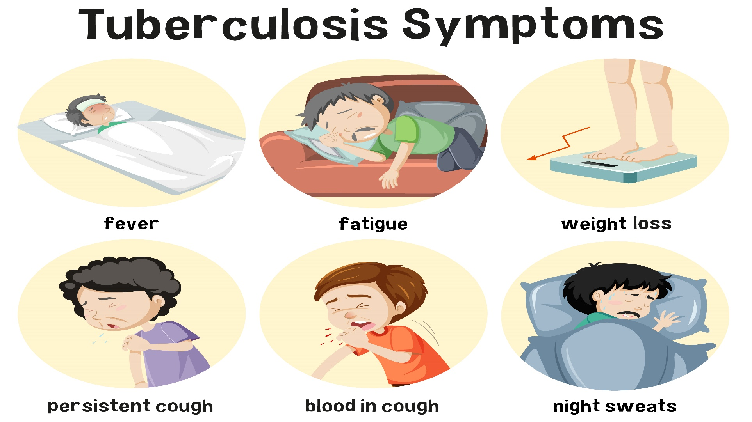
Symptoms

Slide 5
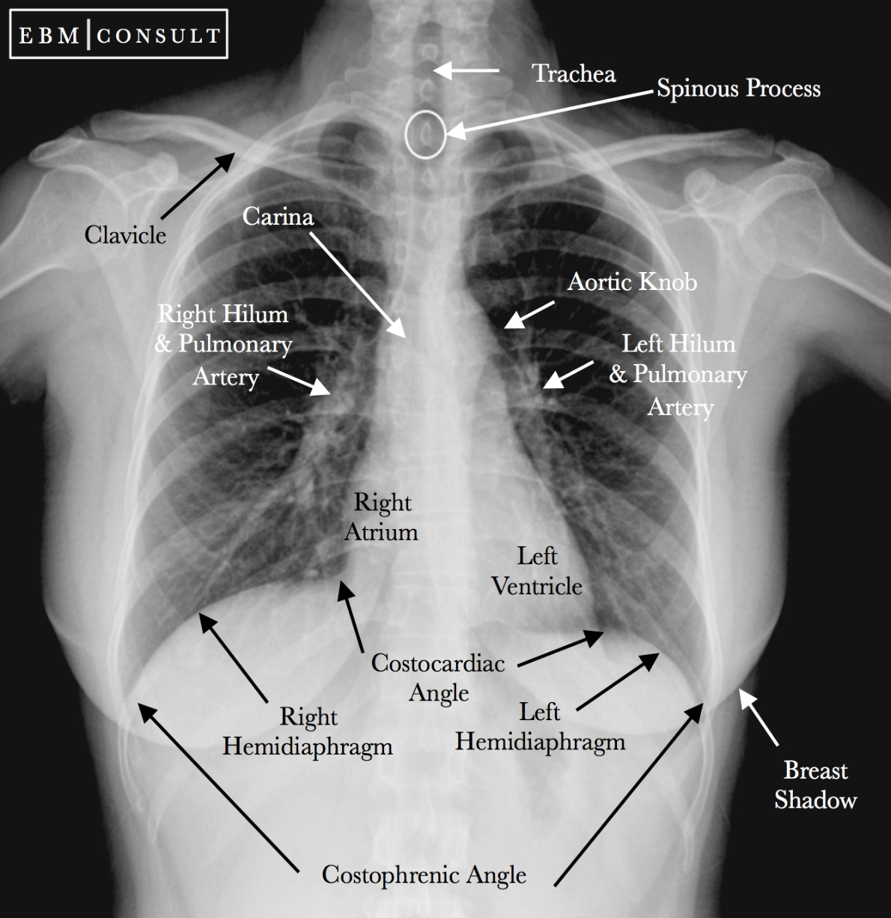
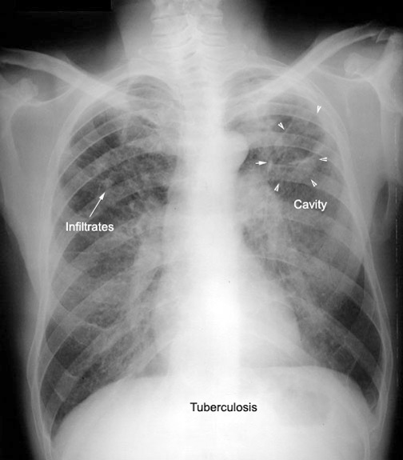
Visual Representation (Normal Vs Cavitation)
Enlarge lymph nodes

Slide 6
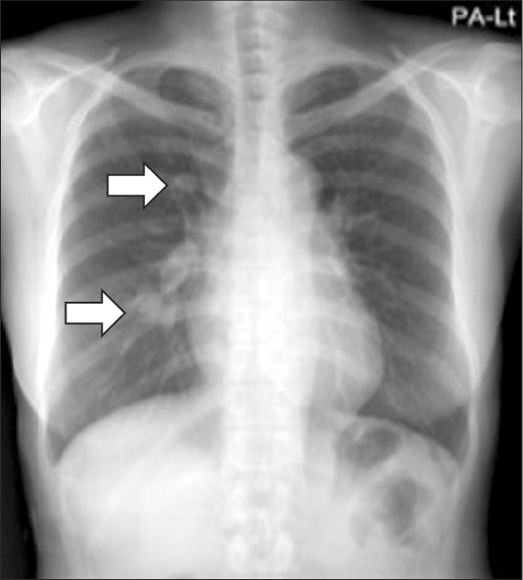
Visual Representation (Nodules)
Lung Nodules are small masses of tissue in the lung that appear as round, white spots on a chest X-ray or computed tomography (CT) scan

Slide 7
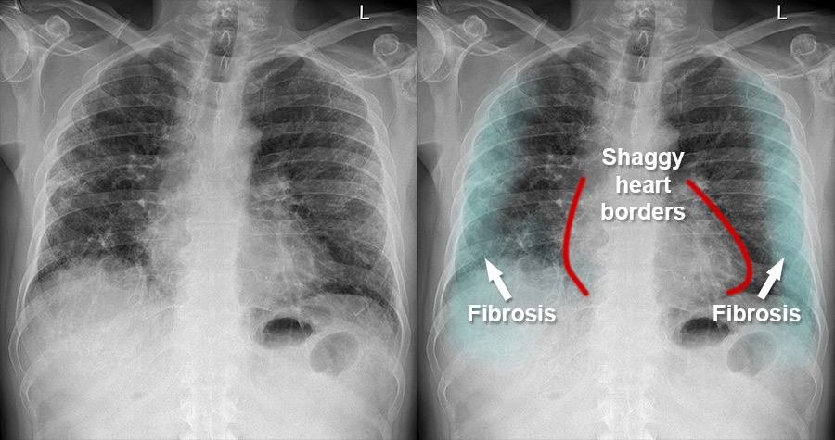
Visual Representation (fibrosis)
Pulmonary fibrosis is scarred and thickened tissue around and between the air sacs called alveoli in the lungs

Slide 8
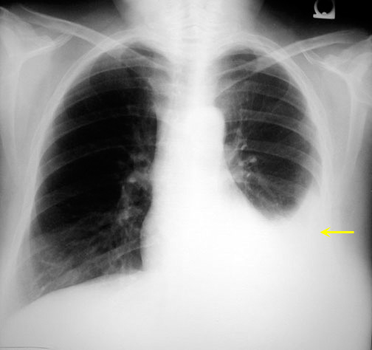
Visual Representation (Pleural effusions)
Fluid gathers in the lowest part of the chest, according to the patient's position

